Slide 1



Clockwork Threads, Randomness
19.06.2023

Slide 2
What will we do today?
1) Turn on Wind on the seven seas
2) Learn how clockwork threads work
3) Dive into Randomness on chain

Slide 3
Turn on the wind

Slide 4
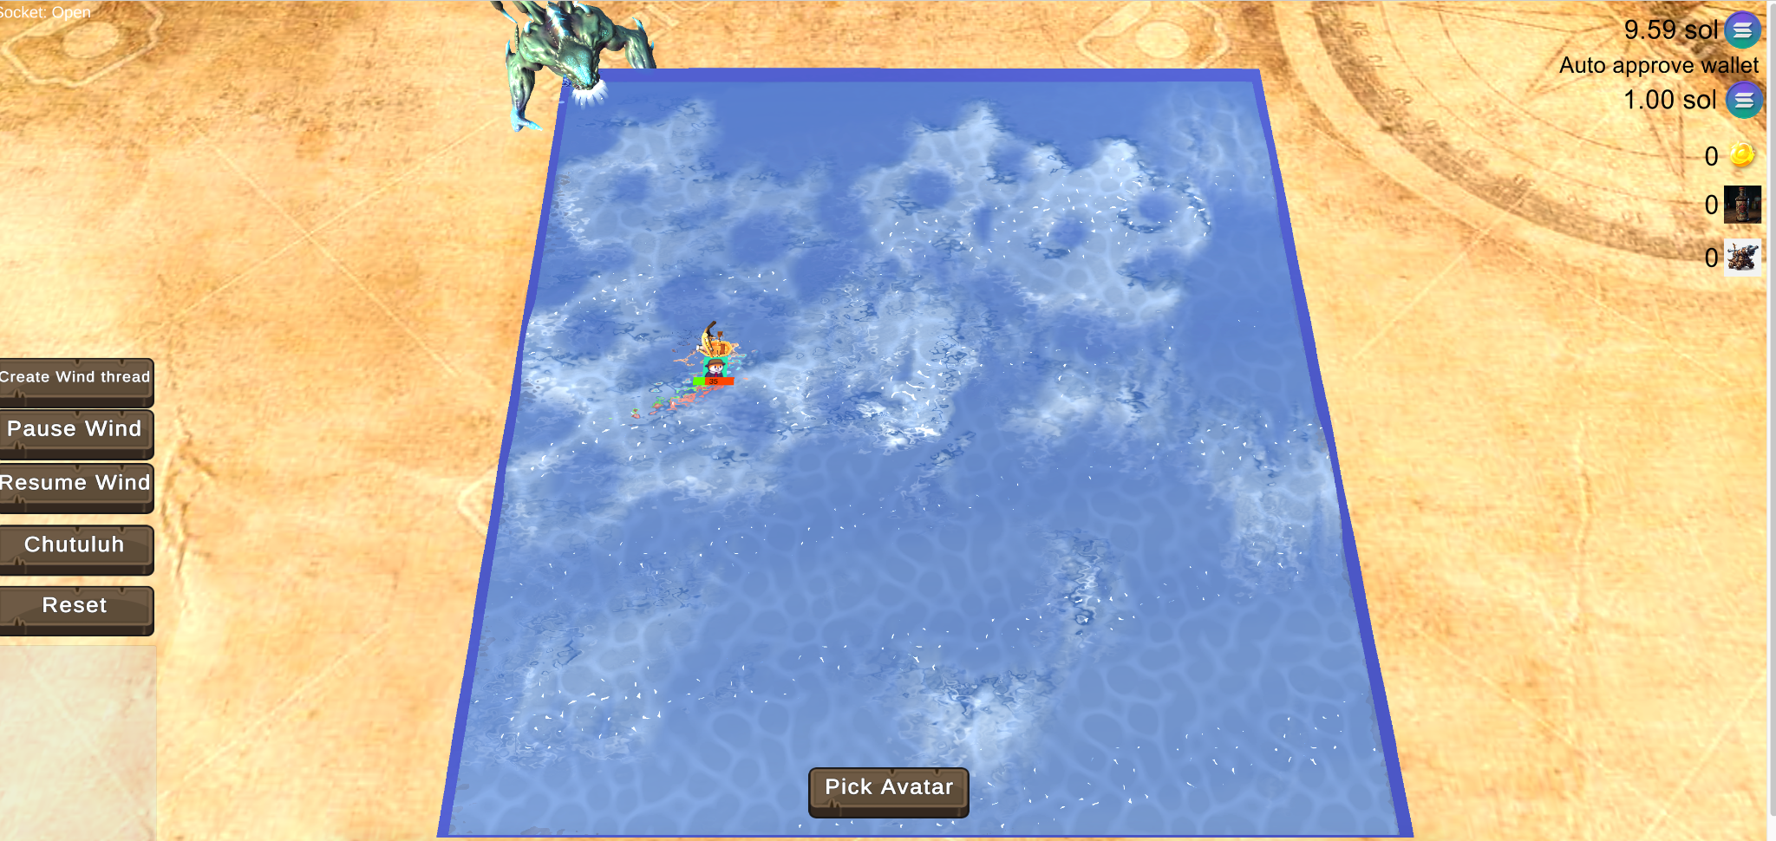
Starting a thread that moves ships
Create a thread which moves ships on chain every few seconds.
https://solplay.de/sevenseas/index.html

Slide 5
Clock work threads

Slide 6
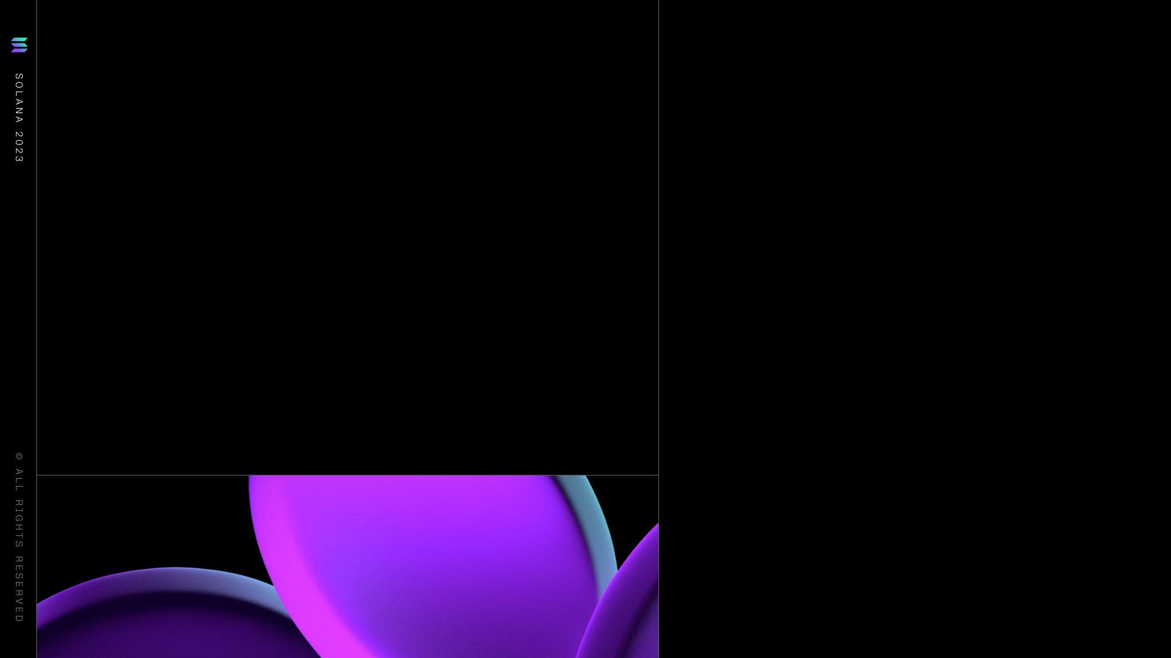
How does clock work work
Create a thread with an instruction on your program
Clock work has a worker network that triggers this instruction
Fees are taken from the thread account
Cost: 0.000001 Sol per instruction

Slide 7
Triggers
Cron notation:
http://www.quartz-scheduler.org/documentation/quartz-2.3.0/tutorials/cro
ntrigger.html
0 0 12 * * ? — Fire at 12pm (noon) every day
Account change:
Liste to pyth oracle to accumulate price data for example
now
slot
epoch
timestamp
pyth (price change)

Slide 8
Use cases + examples
1. Hello Clockwork – Prints "Hello world" and the current timestamp every 10 seconds
2. Counter – Creates a thread via CPI that increments a counter every 10 seconds
Recurring payments – Executes an SPL token transfer on a user-defined schedule.
Token distributor – Mints a new token and sends it to a target user every 60 seconds.
Dollar cost averaging – Executes a swap on Serum on a user-defined schedule.
Serum crank – Indefinitely processes open orders on a permissioned Serum market.
Subscriptions – Allow users to subscribe to subscriptions by paying on a recurrent schedule.

Slide 9
Idle game example

Slide 10
Live coding
- Please checkout:
https://github.com/solana-developers/solana-game-starter-kits/
and open idle-game folder in CS code
cd program
npm i
anchor build
anchor test
cd ..
cd app
npm i
npm run dev

Slide 11
Randomness on chain

Slide 12
xOrShift
The easiest way to create pseudo random numbers in a program.
pub struct XorShift64 {
a: u64,
}
impl XorShift64 {
pub fn next(&mut self) -> u64 {
let mut x = self.a;
x ^= x << 13;
x ^= x >> 7;
x ^= x << 17;
self.a = x;
x
}
}

Slide 13
Usage in Seven Seas
// Init with a static seed to always get the same output with the same input
let mut rng = XorShift64 {
a: tile.health as u64,
};
let chtulu_damage: u64 = 10;
let damage_variant = ((chtulu_damage as f64) * 0.3).ceil() as u64;
let damage = chtulu_damage + ((rng.next() % damage_variant) + 1);

Slide 14
xOrShift64Star
A more random version
pub fn xorshift64star(seed: u64) -> u64 {
let mut x = seed;
x ^= x << 12;
x ^= x >> 25;
x ^= x << 27;
x = (x as u128 * 0x2545F4914F6CDD1D) as u64;
x
}

Slide 15
Combine with block hash
pub fn xorshift(_ctx: Context<Rng>, max_value: u64) -> Result<()> {
let slot = Clock::get()?.slot;
let xorshift_output = xorshift64star(slot);
let random_number = xorshift_output % max_value;
msg!("Slot: {}", slot);
msg!("Xorshift: {}", xorshift_output);
msg!("Random Number: {}", random_number);
Ok(())
}

Slide 16
Hashing function
pub fn sha256(_ctx: Context<Rng>, max_value: u64) -> Result<()> {
let slot = Clock::get()?.slot;
let mut hasher = Sha256::new();
hasher.update(slot.to_be_bytes());
let hash = hasher.finalize();
let random_number = u64::from_be_bytes(hash[..8].try_into().unwrap()) % max_value;
msg!("Random Number: {}", random_number);
Ok(())
}

Slide 17
Block hash is not 100% save
A malicious validator can fill up the block with dust and influence the block hash that way. While unlikely exploiting randomness has happened before.
$COPE roulette exploited when using the recent blockhash for pseudo randomness
Trash Panda mint sniped by bots due to predictable mint order

Slide 18
Solution is using an oracle
“Switchboard’s VRF implementation uses the VRF counter and the recent blockhash as the VRF input to prevent oracles from gaining an unfair advantage. Unfortunately, this means that just like any other blockchain VRF protocol, there exists a collusion vector between the oracle and the block-producer, however, it is much more secure than simply using the blockhash on its own on its own for randomness!”

Slide 19
How it works
Request randomness
Oracle does a CPI to your program with the random value
Consume Randomness
Cost: 0.002 Sol per random value

Slide 20
Randomness Resources
Different randomness function implementations:
https://github.com/ZYJLiu/anchor-rng/blob/master/programs/anchor-rng/src/lib.rs
Coin flip example using VRF Switchboard implementation:
https://github.com/solana-developers/solana-game-starter-kits/blob/main/coin-flip/program/programs/coin-flip/src/lib.rs
XorShift explained:
https://en.wikipedia.org/wiki/Xorshift
Article about switchboard randomness:
https://switchboardxyz.medium.com/verifiable-randomness-on-solana-46f72a46d9cf
Playground Tutorial Boss Battles:
https://beta.solpg.io/tutorials/boss-battle

Slide 21
Let’s build a coin flip game
Please check out:
https://github.com/solana-developers/solana-game-starter-kits/
and open coin-flip folder in CS code
cd program
npm i
anchor build
anchor test
cd ..
cd app
npm i
npm run dev

Slide 22
Resources
Seven seas: https://github.com/solana-developers/solana-game-starter-kits/tree/main/seven-seas
Zero copy example:
https://beta.solpg.io/tutorials/zero-copy
https://github.com/solana-developers/anchor-zero-copy-example/blob/main/README.md
Randomness example:
https://beta.solpg.io/tutorials/battle-coins
Clockwork: https://www.clockwork.xyz/
Example idle game: https://github.com/solana-developers/solana-game-starter-kits/tree/main/idle-game

